Slide 1
Mathematical Foundations for ML (10-606):
Probability
Bryan Wilder
* Slides borrowed from prior offerings by Professors M. Gormley, P. Virtue, & G. Gordon, & H. Heidari.

Slide 2
Probability Vocab
Outcomes
Sample space
Events
Probability
Random variable
Discrete random variable
Continuous random variable
Probability mass function
Probability density function
Parameters

Slide 3
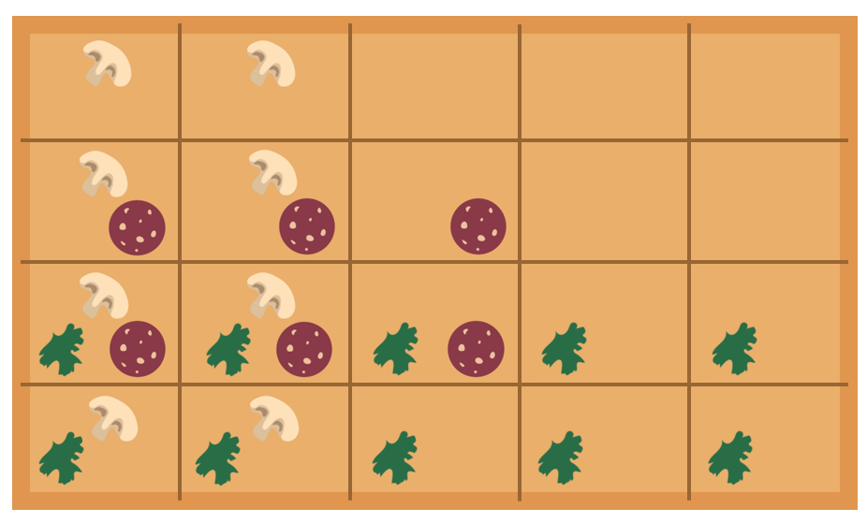




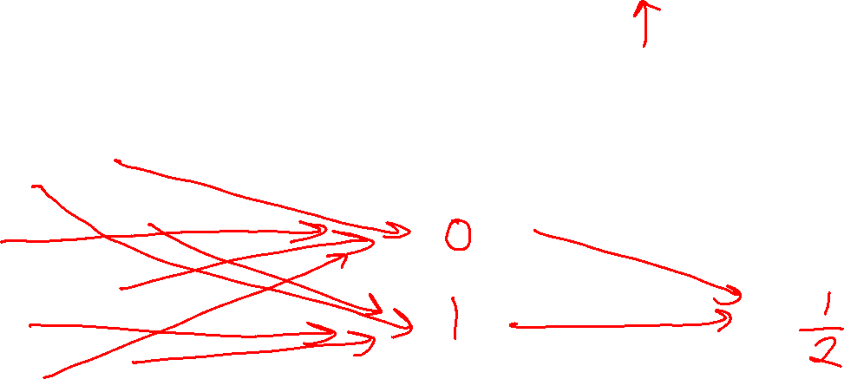
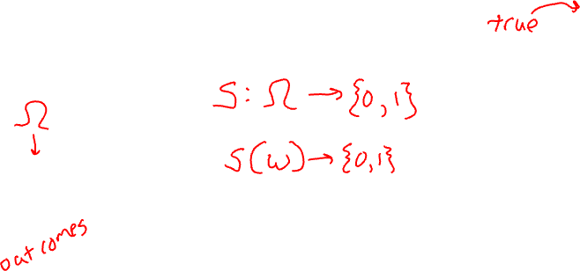
Example
Random variable for spinach or no spinach
Random variable
Distribution
Sample space
Values of a RV
Probabilities or Densities
Icons: CC, https://openclipart.org/detail/296791/pizza-slice

Slide 4
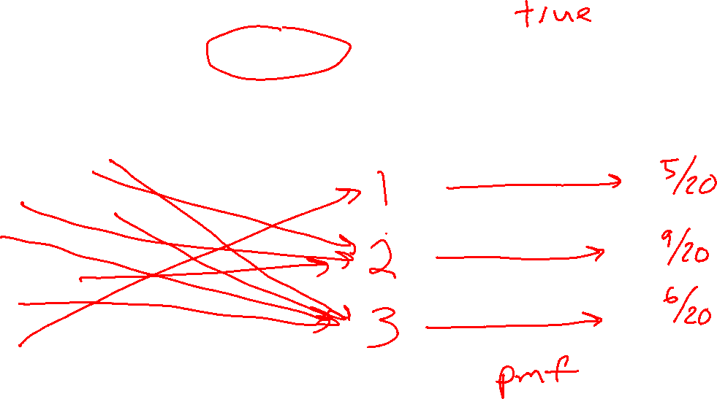
Example
Random variable for topping type with
three categories: none, non-meat, meat
Random variable
Distribution
Sample space
Values of a RV
Probabilities or Densities
Icons: CC, https://openclipart.org/detail/296791/pizza-slice

Slide 5
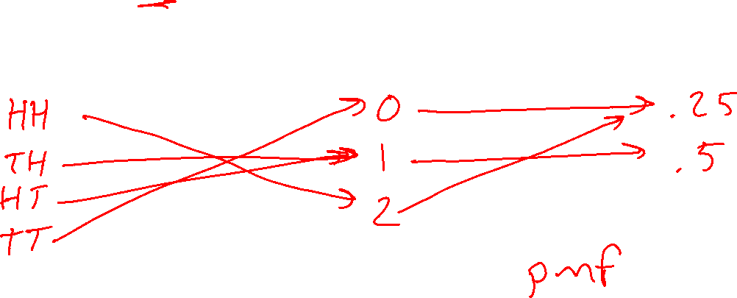
Example
Random variable for number of heads after two flips of a fair coin
Random variable
Distribution
Sample space
Values
Probabilities or Densities
Icons: CC, https://openclipart.org/detail/296791/pizza-slice

Slide 6
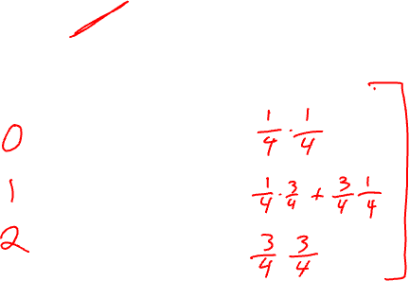
Example
Random variable for number of heads after two flips of a biased coin with heads 75%
Random variable
Distribution
Sample space
Values
Probabilities or Densities
Icons: CC, https://openclipart.org/detail/296791/pizza-slice

Slide 7
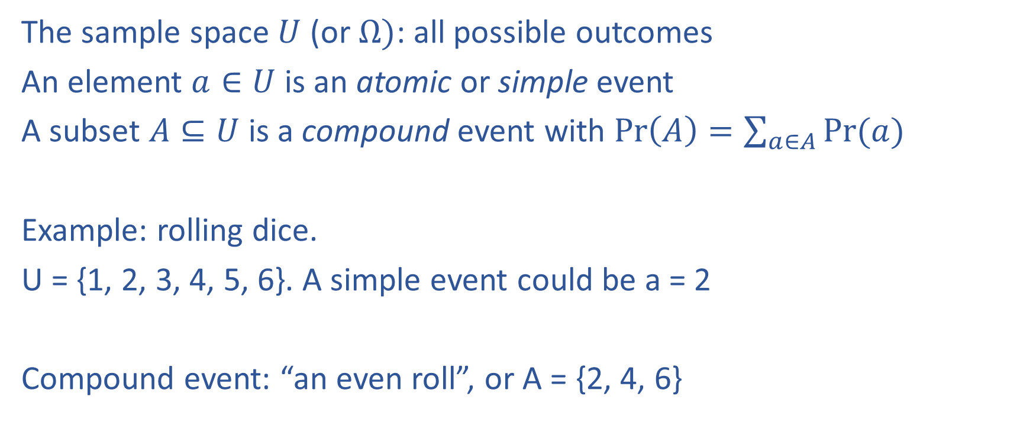
Formalization
The sample space $U$ (or $Ω)$: all possible outcomes
An element $a∈U$ is an atomic or simple event
A subset $A⊆U$ is a compound event with $\operatorname{Pr}\left(A\right)=\sum_{a∈A}{Pr⁡(a)}$
Example: rolling dice.
U = {1, 2, 3, 4, 5, 6}. A simple event could be a = 2
Compound event: “an even roll”, or A = {2, 4, 6}

Slide 8
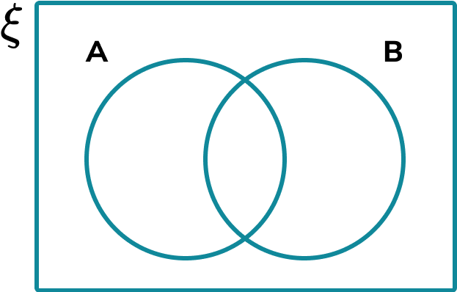
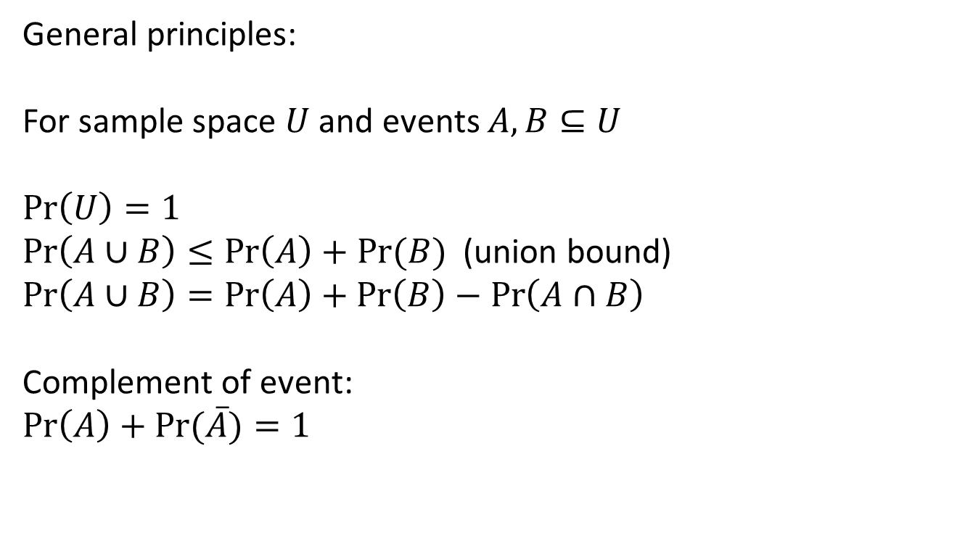
Formalization
General principles:
For sample space $U$ and events $A, B⊆U$
$$\operatorname{Pr}\left(U\right)=1$$
$\operatorname{Pr}\left(A∪B\right)≤\operatorname{Pr}\left(A\right)+Pr⁡(B)$ (union bound)
$$\operatorname{Pr}\left(A∪B\right)=\operatorname{Pr}\left(A\right)+\operatorname{Pr}\left(B\right)−\operatorname{Pr}\left(A∩B\right)$$
Complement of event:
$$\operatorname{Pr}\left(A\right)+\operatorname{Pr}{(\overline{A})}=1$$

Slide 10
Probability table
Outcome | Probability
HH | 1/4
HT | 1/4
TH | 1/4
TT | 1/4

Slide 11
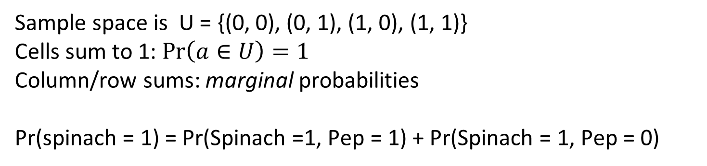
Probability table: joint probabilities
 | Peperoni = 1 | Peperoni = 0
Spinach = 1 | 1/2 | 1/8
Spinach = 0 | 1/8 | 1/4
Sample space is U = {(0, 0), (0, 1), (1, 0), (1, 1)}
Cells sum to 1: $\operatorname{Pr}\left(a∈U\right)=1$
Column/row sums: marginal probabilities
Pr(spinach = 1) = Pr(Spinach =1, Pep = 1) + Pr(Spinach = 1, Pep = 0)

Slide 12
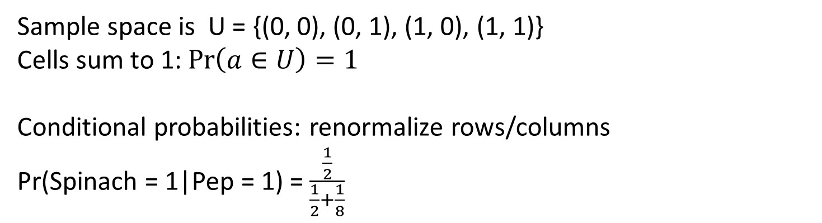
Probability table: joint probabilities
 | Peperoni = 1 | Peperoni = 0
Spinach = 1 | 1/2 | 1/8
Spinach = 0 | 1/8 | 1/4
Sample space is U = {(0, 0), (0, 1), (1, 0), (1, 1)}
Cells sum to 1: $\operatorname{Pr}\left(a∈U\right)=1$
Conditional probabilities: renormalize rows/columns
Pr(Spinach = 1|Pep = 1) = $\frac{\frac{1}{2}}{\frac{1}{2}+\frac{1}{8}}$

Slide 13
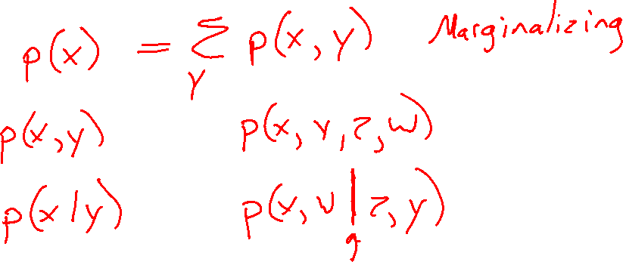
Probability Vocab
Marginal
Joint
Conditional

Slide 14
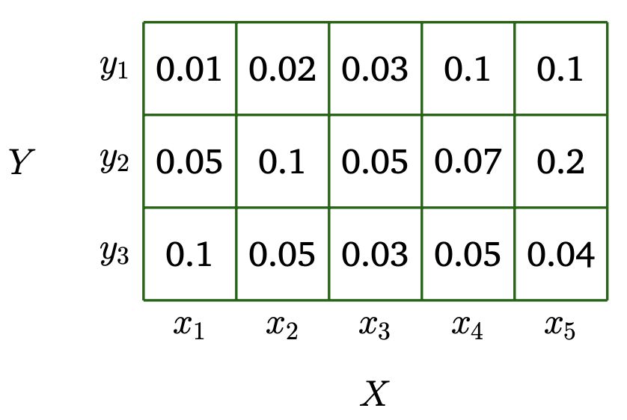
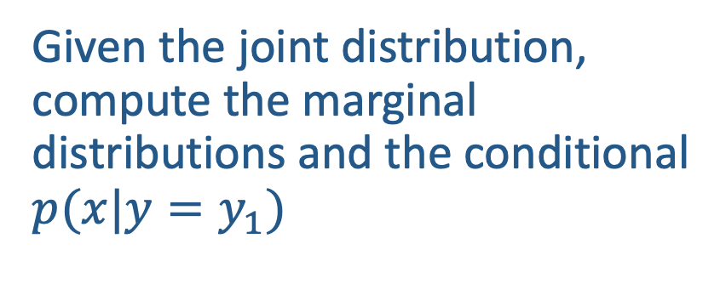
Given the joint distribution, compute the marginal distributions and the conditional $p(x|y=y_{1})$

Slide 15
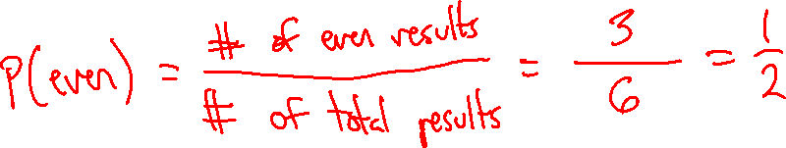
Uniform Distributions
Recall that in a uniform distribution, each atomic event has an equally likely chance of occurring.
In these settings, computing the probability of a compound event reduces to counting!
For example, suppose you have a fair six-sided die. The probability of rolling an even number is

Slide 16
Uniform Distributions
Recall that in a uniform distribution, each atomic event has an equally likely chance of occurring.
In these settings, computing the probability of a compound event reduces to counting!
Sometimes counting is hard…
For example, what is the probability of drawing a 5-card hand from a standard 52 card deck that contains exactly 3 cards of the same value e.g., 3 fours or 3 aces?

Slide 17
Uniform Distributions
What is the probability of getting 3 heads in a row with a fair coin?

Slide 18
Uniform Distributions
Consider a biased coin that comes up heads with probability ¾. What is the probability of getting 3 heads total in a sequence of four flips?

Slide 19
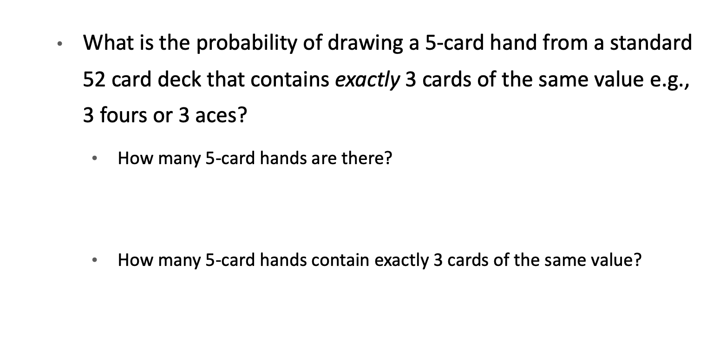
Uniform Distributions
What is the probability of drawing a 5-card hand from a standard 52 card deck that contains exactly 3 cards of the same value e.g., 3 fours or 3 aces?
How many 5-card hands are there?
$$\left({52 \atop 5}\right)=\frac{52!}{\left(52−5\right)!5!}=2,598,960$$
How many 5-card hands contain exactly 3 cards of the same value?

Slide 20
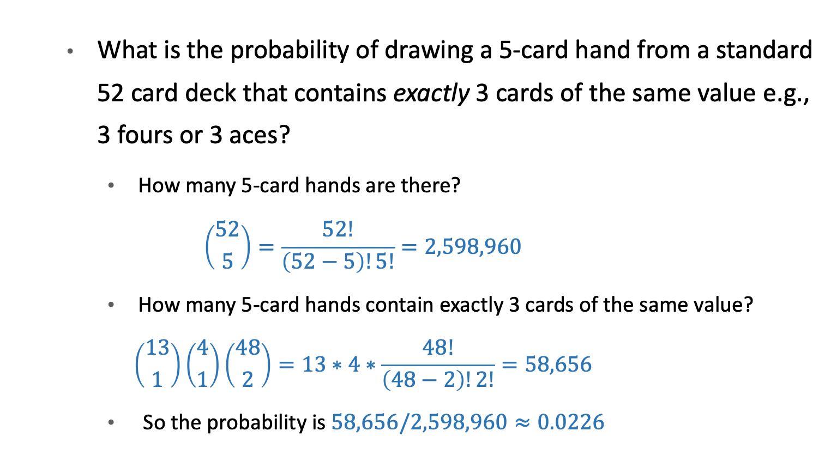
Combinatorics
What is the probability of drawing a 5-card hand from a standard 52 card deck that contains exactly 3 cards of the same value e.g., 3 fours or 3 aces?
How many 5-card hands are there?
$$\left({52 \atop 5}\right)=\frac{52!}{\left(52−5\right)!5!}=2,598,960$$
How many 5-card hands contain exactly 3 cards of the same value?
$$\left({13 \atop 1}\right)\left({4 \atop 1}\right)\left({48 \atop 2}\right)=13∗4∗\frac{48!}{\left(48−2\right)!2!}=58,656$$
So the probability is $58,656/2,598,960≈0.0226$

Slide 21
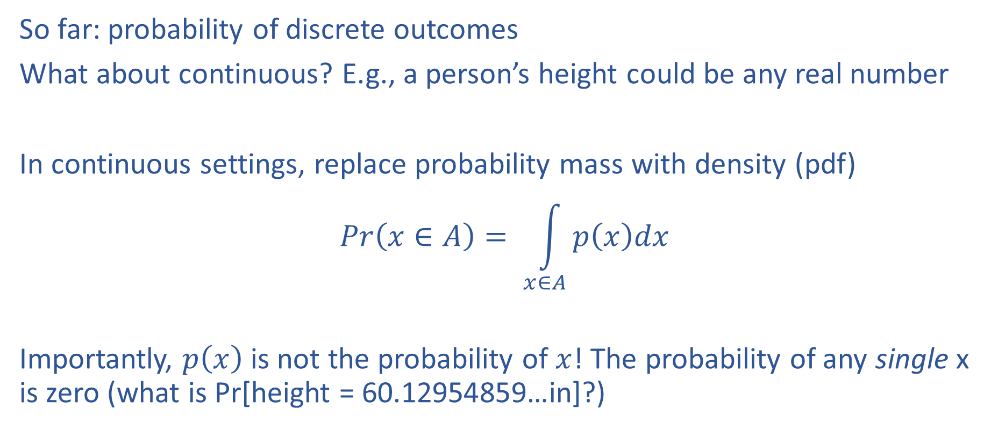
Continuous distributions
So far: probability of discrete outcomes
What about continuous? E.g., a person’s height could be any real number
In continuous settings, replace probability mass with density (pdf)
$$Pr\left(x∈A\right)= \int_{x∈A}{p\left(x\right)dx}$$
Importantly, $p\left(x\right)$ is not the probability of $x$! The probability of any single x is zero (what is Pr[height = 60.12954859…in]?)

Slide 22
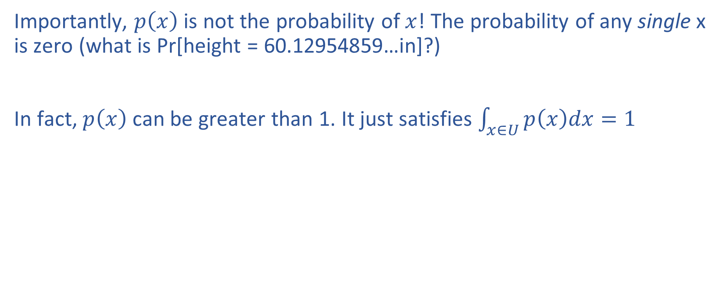
Continuous distributions
Importantly, $p\left(x\right)$ is not the probability of $x$! The probability of any single x is zero (what is Pr[height = 60.12954859…in]?)
In fact, $p\left(x\right)$ can be greater than 1. It just satisfies $\int_{x∈U}{p\left(x\right)dx=1}$

Slide 23
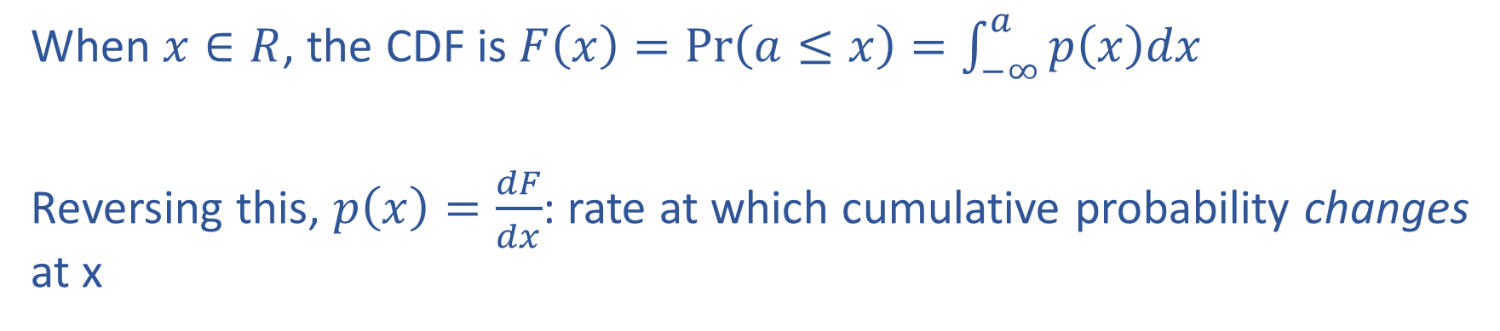
Cumulative distribution functions
When $x∈R$, the CDF is $F\left(x\right)=\operatorname{Pr}\left(a≤x\right)=\int_{−∞}^{a}{p\left(x\right)dx}$
Reversing this, $p\left(x\right)=\frac{dF}{dx}$: rate at which cumulative probability changes at x

Slide 24
Parametric distributions
Common families of distributions which set a functional form for the mass or density function
Go-to tools for writing down models, doing analysis, etc

Slide 25
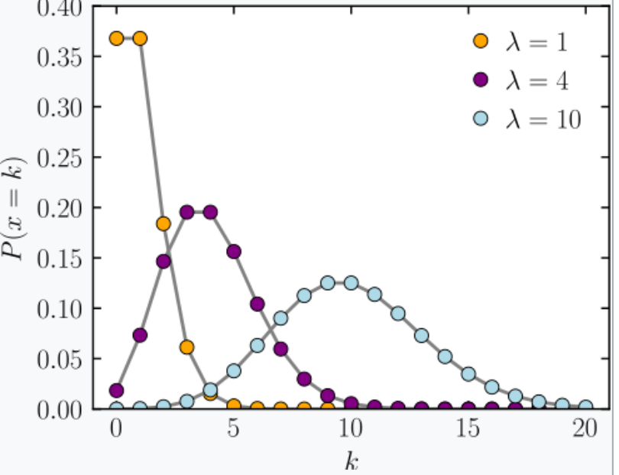
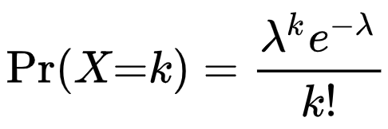
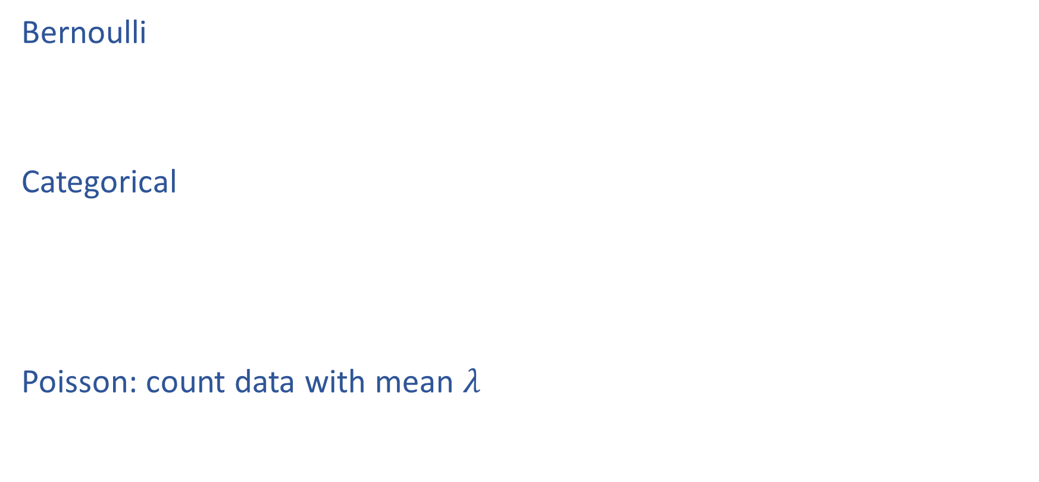
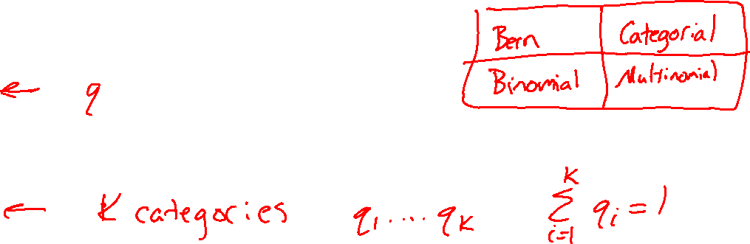
Example Discrete Distributions
Bernoulli
Categorical
Poisson: count data with mean $λ$
https://en.wikipedia.org/wiki/Poisson_distribution

Slide 26
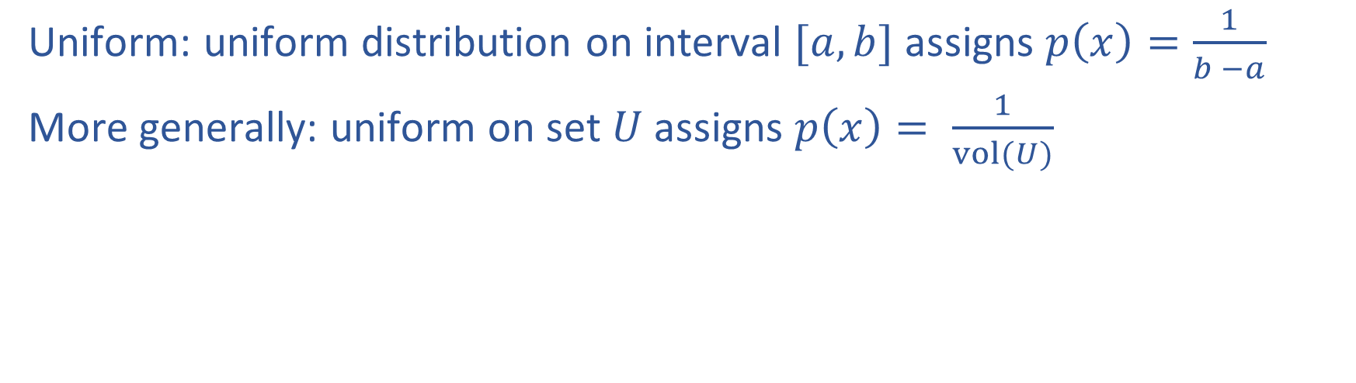
Continuous distributions
Uniform: uniform distribution on interval $[a,b]$ assigns $p\left(x\right)=\frac{1}{b −a}$
More generally: uniform on set $U$ assigns $p\left(x\right)= \frac{1}{vol(U)}$

Slide 27
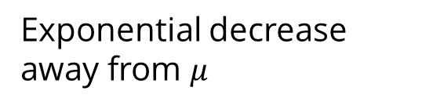
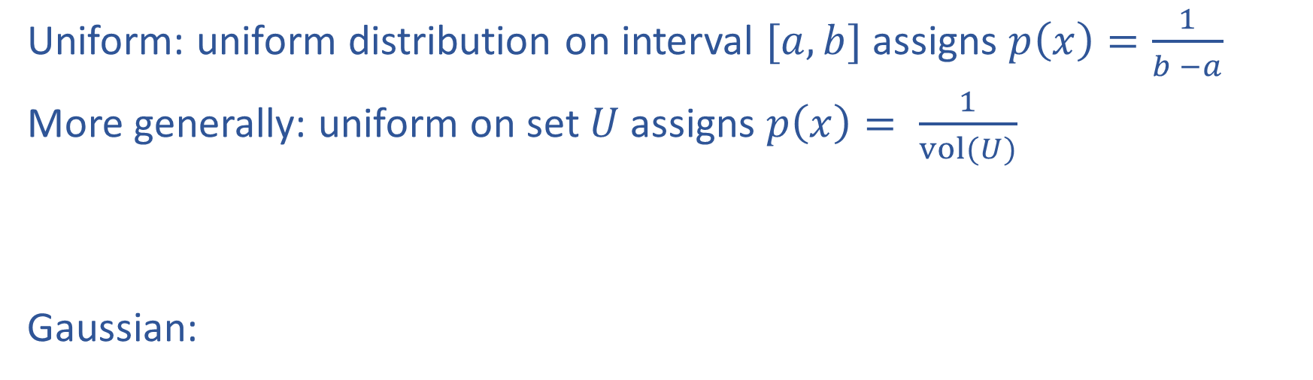
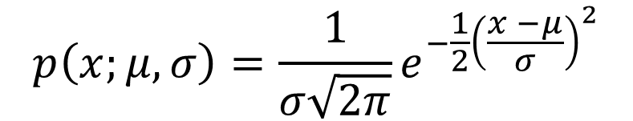
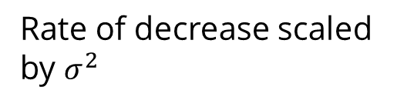
Continuous distributions
Uniform: uniform distribution on interval $[a,b]$ assigns $p\left(x\right)=\frac{1}{b −a}$
More generally: uniform on set $U$ assigns $p\left(x\right)= \frac{1}{vol(U)}$
Gaussian:
Exponential decrease away from $μ$
$$p\left(x;μ, σ\right)=\frac{1}{σ\sqrt{2π}}e^{−\frac{1}{2}{\left(\frac{x −μ}{σ}\right)}^{2}}$$
Rate of decrease scaled by $σ^{2}$
mean
Standard deviation

Slide 28
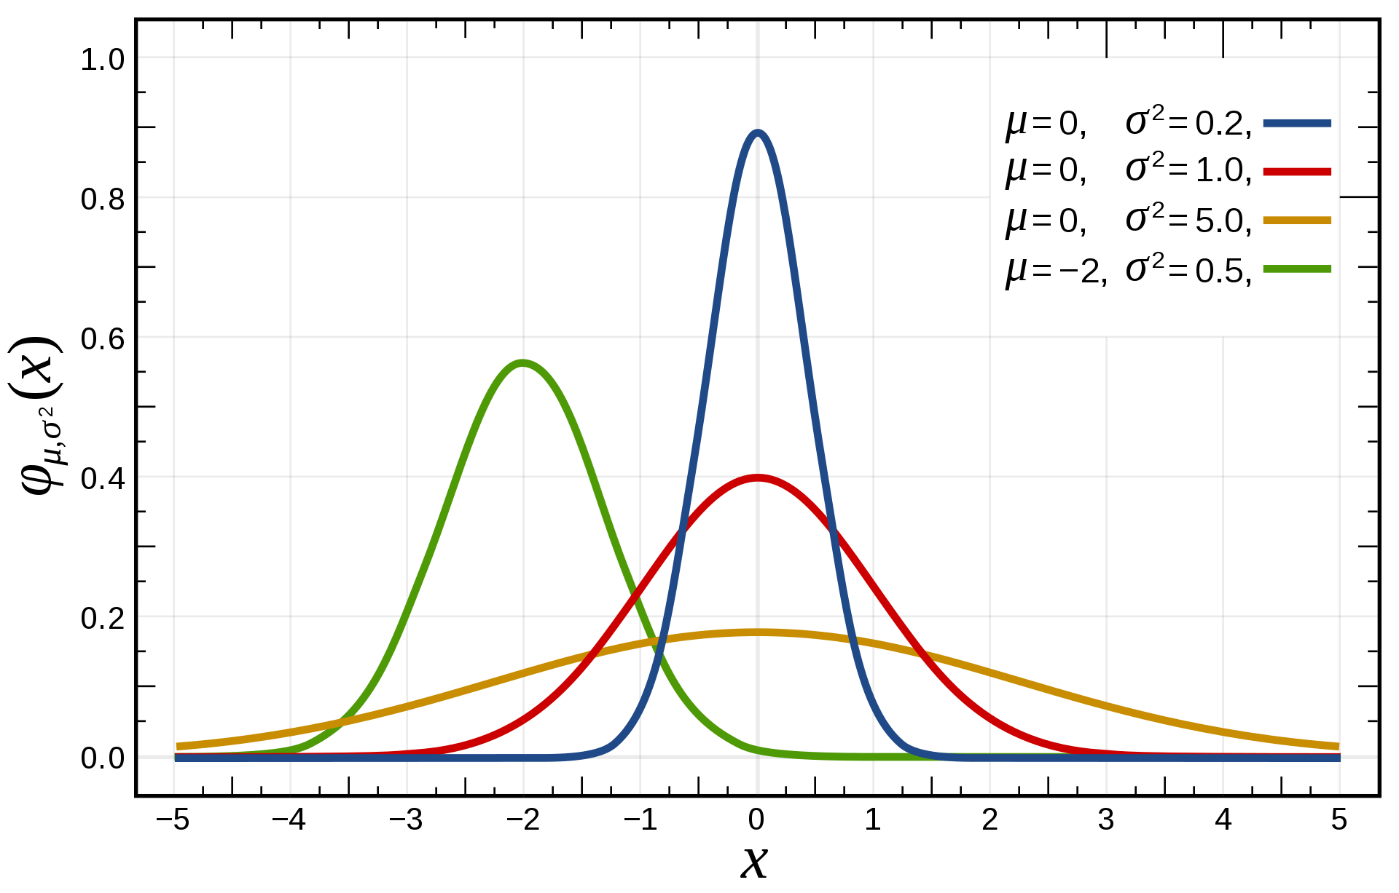
$$p\left(x;μ, σ\right)$$

Slide 29
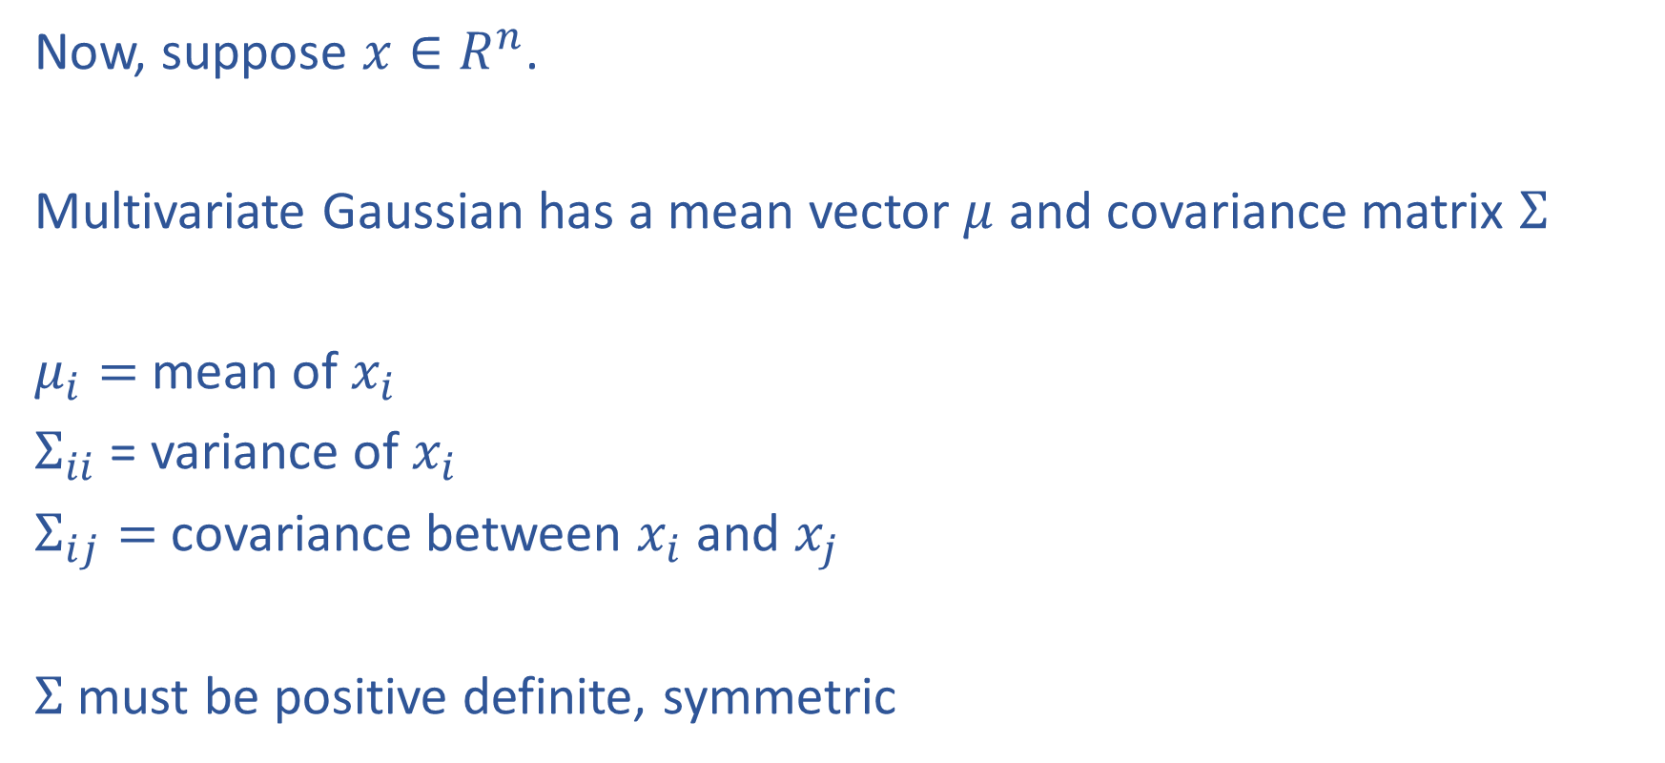
Multivariate Gaussian
Now, suppose $x∈R^{n}$.
Multivariate Gaussian has a mean vector $μ$ and covariance matrix $Σ$
$μ_{i}=$mean of $x_{i}$
$Σ_{ii}$ = variance of $x_{i}$
$Σ_{ij}=$covariance between $x_{i}$ and $x_{j}$
$Σ$ must be positive definite, symmetric

Slide 30
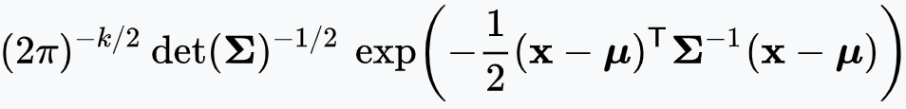
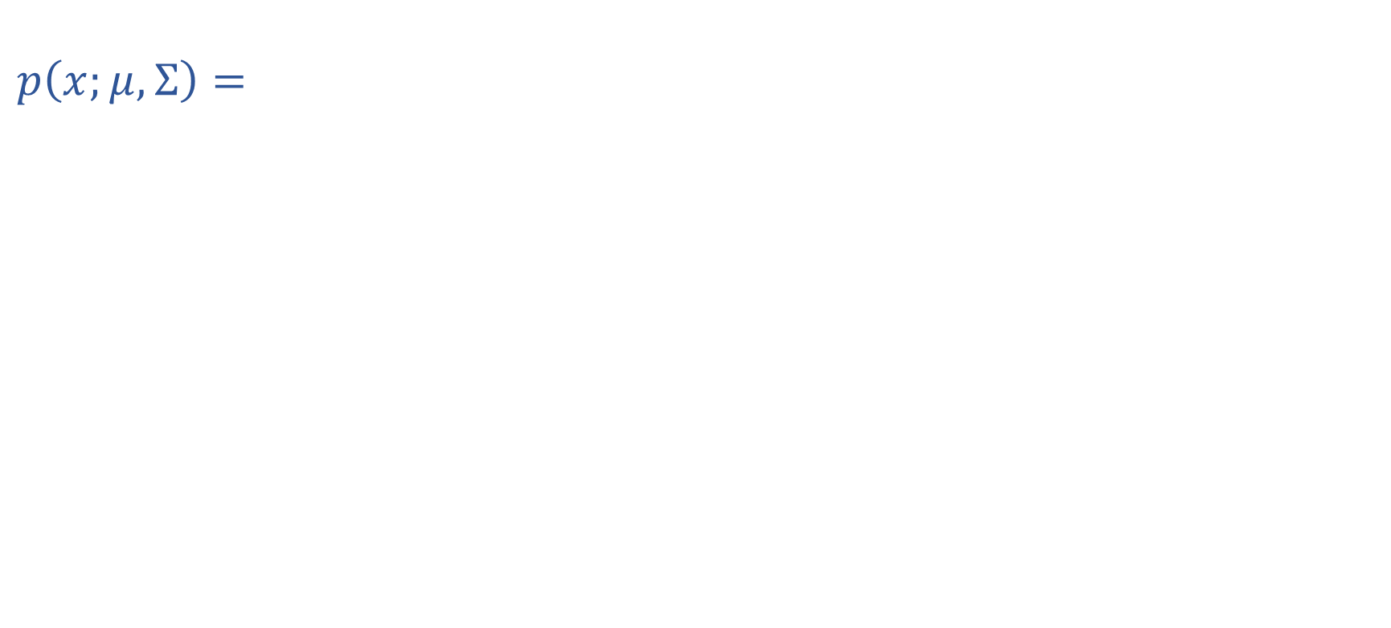
Multivariate Gaussian
$$p\left(x;μ, Σ\right)=$$
Distance from $x$ to $μ$ under norm induced by $Σ^{−1}$

Slide 31
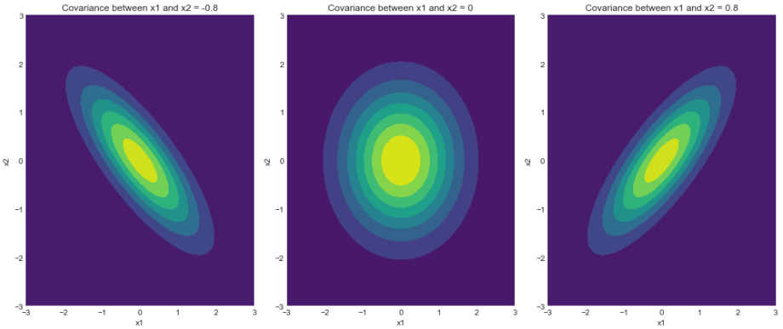
Multivariate Gaussian
https://www.geeksforgeeks.org/visualizing-the-bivariate-gaussian-distribution-in-python/

Slide 32
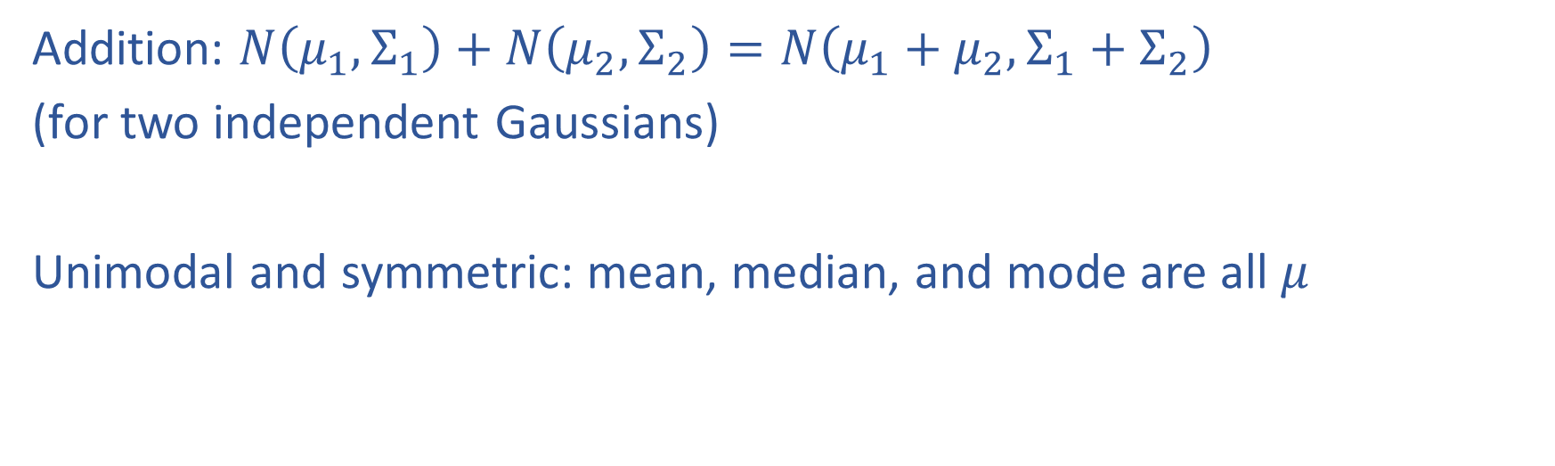
Properties of Gaussians
Addition: $N\left(μ_{1}, Σ_{1}\right)+N\left(μ_{2}, Σ_{2}\right)=N\left(μ_{1}+μ_{2}, Σ_{1}+Σ_{2}\right)$
(for two independent Gaussians)
Unimodal and symmetric: mean, median, and mode are all $μ$

Slide 33
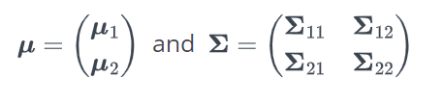
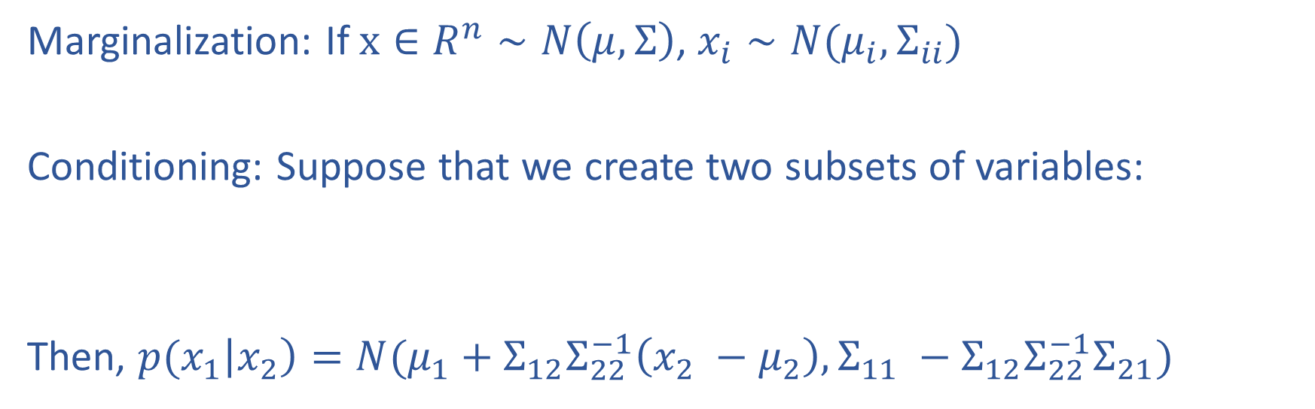
Properties of Gaussians
Marginalization: If $x∈R^{n}∼N\left(μ, Σ\right)$, $x_{i}∼N(μ_{i}, Σ_{ii})$
Conditioning: Suppose that we create two subsets of variables:
Then, ${p(x}_{1}\left|x_{2}\right)=N(μ_{1}+Σ_{12}Σ_{22}^{−1}\left(x_{2} −μ_{2}\right), Σ_{11} −Σ_{12}Σ_{22}^{−1}Σ_{21})$

Slide 34
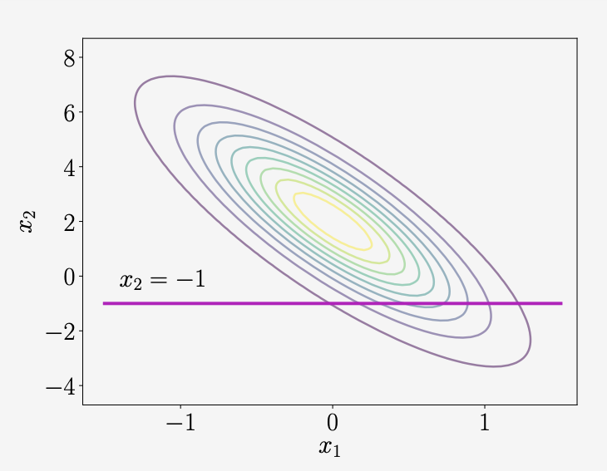
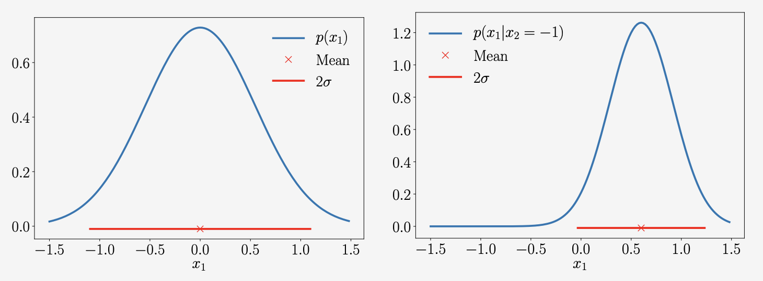
Example
Marginal
Conditional

Slide 35
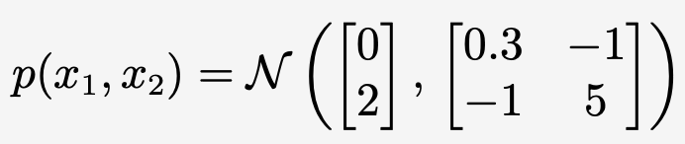
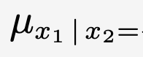
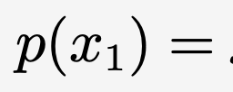
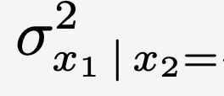
Example

